Slide 1
INTRODUCTION TO GENDER, HIV & AIDS.
Agricultural Gender Roles Extension Support Services.

Slide 2
OBJECTIVES OF THE PRESENTATION
By the end of the module participants will be able to:
Define gender
Define important terminologies in gender
Explain factors that fuel HIV and AIDS
Explain the relationship between gender, HIV and AIDS.
Agricultural Gender Roles Extension Support Services.

Slide 3
PRESENTATION OUTLINE
Introduction
Gender concepts
HIV and AIDS fueling factors
Relationship between gender, HIV and AIDS.
conclusion
Agricultural Gender Roles Extension Support Services.

Slide 4
INTRODUCTION
Men and women both constitute the population (48% men and 52% women) and contribute to development
Men, women, boys and girls are prime agents of development
If both women and men have better access and control over resources, income and productivity increases.
Agricultural Gender Roles Extension Support Services.

Slide 5
INTRODUCTION
Benefits of development must be equally shared
Incorporating gender consideration into development planning is a more cost effective use of human, financial and other resources, resulting in increased productivity and sustainable development.
Agricultural Gender Roles Extension Support Services.

Slide 6
GENDER CONCEPTS
GENDER
Socially constructed roles, relationships, responsibilities status and privileges assigned to men, women, boys and girls in a given culture or location.
Learnt through the socialization process
Gender relations are dynamic, changeable, and vary from culture to culture
Agricultural Gender Roles Extension Support Services.

Slide 7
EXERCISE
GROUP WORK ON GENDER CONCEPTS
Agricultural Gender Roles Extension Support Services. June 2008

Slide 8
GENDER CONCEPTS
GENDER ROLES
They are different roles and responsibilities assigned to men and women, boy girls.
Socially determined and can be changed.
Are culturally defined roles and responsibilities to which women and men socialized to conform to.
Affected by age, class, religious, ethnicity and historic trends
Agricultural Gender Roles Extension Support Services.

Slide 9
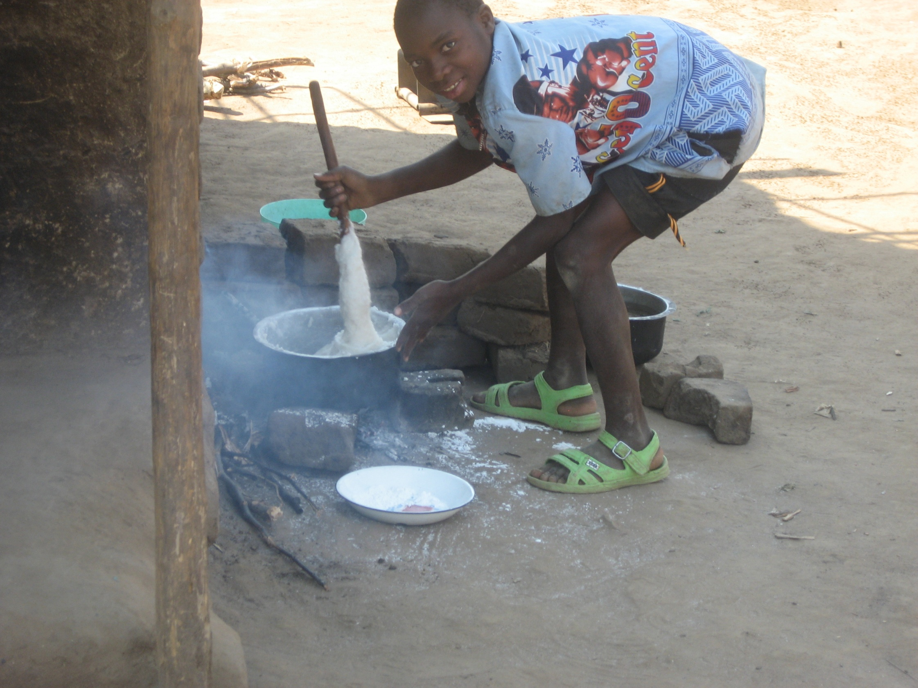

Slide 10
GENDER CONCEPTS …….
  Gender Concerns
Inequalities or unfairness that arise from different situations due to ones gender and the ones affected do not recognize that they have a problem or talk about it.
For example:
  Lack of skills
  Lack of representation
  Inequitable distribution of resources and benefits
Agricultural Gender Roles Extension Support Services.

Slide 11
GENDER CONCEPTS …….
  Gender Issue
Inequality or unfair treatment felt by one gender category in that their needs are not being met, e.g Inaccessibility to loans.
The ones disadvantaged realizes the unfair treatment and often talks about it after being empowered.
Agricultural Gender Roles Extension Support Services.

Slide 12
GENDER CONCEPTS …….
Gender Gap
Refers to the quantitative or qualitative differences between men and women, boys and girls on any social economic indicator.
For example literacy rate: female literacy rate is 44% while male’s is 75% with a gender gap of 31%.
Agricultural Gender Roles Extension Support Services.

Slide 13
GENDER CONCEPTS …….
Gender Disparities
These are overall qualitative and quantitative differences among women, men, boys and girls as a result of the critical analysis of the issues, concerns and gaps.
  power relations and responsibilities
  access and control of resources and benefits,
  position in the society, privileges, education.
Agricultural Gender Roles Extension Support Services.

Slide 14
GENDER CONCEPTS…….
Gender equity
Being fair and socially just and impartial through fair distribution of resources and benefits
A stage or process to equality

Slide 15
GENDER CONCEPTS …….
Gender Equality
Having the same status, rights and responsibilities for men and women
Based on the fact that no individual should be less privileged in opportunities and rights
Involves identification and removal of underlying causes of discrimination to give everyone chance
Agricultural Gender Roles Extension Support Services.

Slide 16
GENDER CONCEPTS …….
Gender Analysis
Systematic assessment of the current and potential roles of men, women, boys, girls and their access and control over resources and benefits within a particular system, project, community or household
Agricultural Gender Roles Extension Support Services.

Slide 17
GENDER CONCEPTS….
Practical Gender Needs (PGN)
Short-term needs of men, women, boys and girls arising from gender roles
Immediate and material in nature – addressed by practical solutions
Basic requirements for survival
Are related to daily needs or welfare requirements
Tangible and quantifiable e.g provision of borehole

Slide 18
GENDER CONCEPTS …….
Strategic Needs
Long term needs
Related to changing or improving positions of individuals in society
Can be addressed by consciousness raising, creating self-confidence, education and mobilization
Are long term therefore difficult to quantify and fulfill e.g education
Agricultural Gender Roles Extension Support Services.

Slide 19
GENDER CONCEPTS …….
Gender Blindness
Lack of recognition of women and men needs
Failure to recognize that gender relations are determinants of life choices available between men, women, boy and girls
Agricultural Gender Roles Extension Support Services. June 2008

Slide 20
GENDER CONCEPTS …….
Gender Sensitivity
To be aware of the difference between men and women needs, roles, responsibilities and constraints and being able to take action to address them.
Means taking into consideration the impact of policies, legislation programmes on women, boy, men and girls
Agricultural Gender Roles Extension Support Services.

Slide 21
HIV
DEFINITION OF HIV
Human
Immunodeficiency
Virus
It weakens immune system

Slide 22
AIDS
AIDS stands for:
Acquired
Immune
Deficiency
Syndrome
A condition of impaired immune system
Results in collection of illnesses, not just one

Slide 23
HIV FUELING FACTORS
Migration to commercial farming estates which provides an opportunity for multiple and concurrent sexual partnership in sending & receiving areas.
Also true for fisher folks.

Slide 24
HIV FUELING FACTORS
Inaccurate HIV and AIDS knowledge
Multiple Partners:
Centre for Social Research Study in Commercial Estates showed that 80% had sex with more than one partner

Slide 25
HIV FUELING FACTORS
Rural development institutions and activities that result in gatherings like rural weekly markets, trading centres.
Institutional arrangements such as marketing and banking which draw farmers away from their families for prolonged periods of time.
Among employees of institutions, absence from home to attend official functions and duties.

Slide 26
HIV FUELING FACTORS
In adequate recreation in the rural areas.
Gender disparity in access and control of benefits.
Low income especially among female farmers and staff.
Food insecurity.
Poverty.
The will to raise ones status without having adequate resources.

Slide 27
RELATIONSHIP BETWEEN GENDER, HIV AND AIDS
Why is HIV and AIDS a gender issue?
There are increasing infections and death rates in women and girls than in men and boys;
Greater burden of care for HIV and AIDS patients are by women and girls than men and boys;
Increasing orphans and female headed households.
Agricultural Gender Roles Extension Support Services.

Slide 28
RELATIONSHIP BETWEEN GENDER, HIV AND AIDS
Women living with HIV and AIDS are not fully accepted and supported resulting in stigma and discrimination;
Female and male heads of households are ill prepared to handle both productive and reproductive roles.
Agricultural Gender Roles Extension Support Services.

Slide 29
RELATIONSHIP BETWEEN GENDER, HIV AND AIDS
In most cases women and children are left without assets thus expose them to high risk behaviour such as
- exchanging sex for money as a means
of survival.
  Such high risk behaviours often lead to STIs including HIV.
Agricultural Gender Roles Extension Support Services.

Slide 30
RELATIONSHIP BETWEEN GENDER, HIV AND AIDS
Why gender is an HIV and AIDS issue?
Gender inequality is one of HIV fueling factors
Gender inequalities make women more vulnerable to the effects of HIV and AIDS

Slide 31
CONCLUSION
Sustainable development can be achieved if only disparities in division of labour or roles, access to and control over resources and benefits are properly addressed for men, women, boys and girls.
Gender equality is an issue of basic human rights, this is affirmed in a number of international and regional human rights instruments such as the UN Charter;

Slide 32
CONCLUSION
Gender can be addressed in its own right just like HIV and AIDS
However they can also be addressed back to back because of the relationships/ links that are there.
Agricultural Gender Roles Extension Support Services. June 2008

Slide 33
THANK YOU FOR YOUR
ACTIVE PARTICIPATION
Agricultural Gender Roles Extension Support Services.

